Slide 1
Travelling Route Generation System
Project Status Presentation V
Zhang Yong, Li Zhihui, Liu Ziyi
17 July, 2019
Project
PROPOSAL

Slide 2
CONTENTS
Progress
Prospect

Slide 3
Progress
01

Slide 4
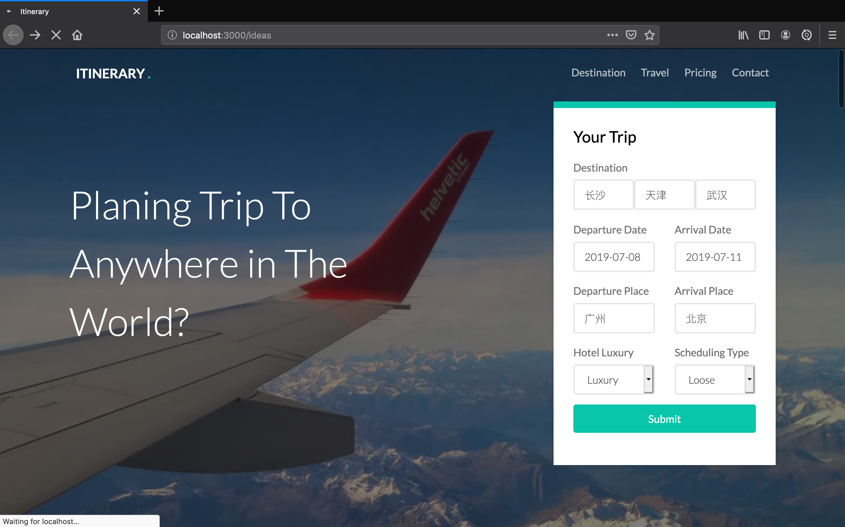
Progress

Slide 5
Progress
1. Hotel recommendation
2. Algorithm optimization
3. Connection between front-end and back-end

Slide 6
Prospect
02

Slide 7
Prospect
1. Report Writing
2. Algorithm Optimization

